Slide 1
Video Game EDA
Taylor Imhof
Bellevue University | DSC 530
Final Project: Exploratory Data Analysis
11/18/2021

Slide 2
Overview
Act as data science consultant for video game studio
Provide insights into which genres, markets, platforms, etc. are the most profitable
Simulated business understanding meeting:
Driving questions:
"Which platform is most likely to maximize profitability?"
"Which region (North America, Japan, EU) should be targeted as primary player base?"
"Are there cases of older games being successful that could use a remake/revival?"
"Which genre/genres are the most profitable?"

Slide 3
EDA Project Objective
Hypothesis: “By analyzing historical game sales data, I will be able to predict which types of video games are the most profitable or highly rated”
Insights from EDA should inform game developers how to best posture for highest likelihood of success/profitability
Practice hands-on EDA techniques learned throughout DSC 530

Slide 4
Dataset
“Video Game Sales with Ratings”
Retrieved from Kaggle.com’s datasets
Tons of useful fields:
Name, platform (PS4, Xbox, etc.), year of release, genre, publisher, sales (NA, EU, JP, global all in millions), critic and user ratings
Most useful will be numeric values
Sales metrics, user/critic metrics (both count and ratings)
Notes:
Data retrieved from Kaggle.com (Kirubi, 2016).
Kirubi, R. (2016). Video Game Sales with Ratings. Kaggle.com. Retrieved from https://www.kaggle.com/rush4ratio/video-game-sales-with-ratings

Slide 5
Variables Explained
NA/EU/JP_Sales + Other and Global Sales
total sales group by these three regions
Certain genres might perform better in different areas
Though will skew largely to NA as largest game consumers
Global sales likely chosen as dependent variables
Best indicator of overall success
Critic and User metrics
Count: total number of reviews for each game
Score: rating given by both critics and users

Slide 6
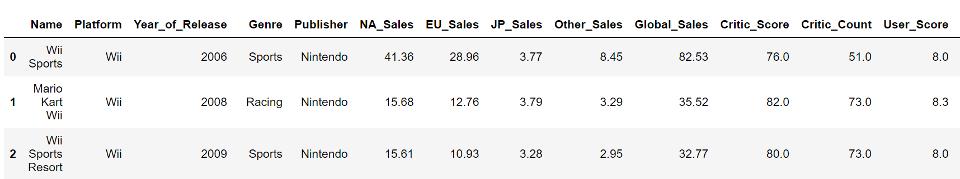
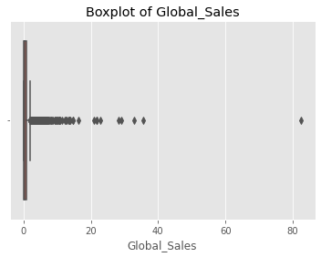



Notable Outliers
Viewing the head() shows ‘Wii Sports’ much high in sales in all sales columns
$82.5M vs next highest $35.5M
Seaborn boxplot also helpful for visualizing outliers
Might be prudent to create subset of dataframe to minimize outlier impact

Slide 7
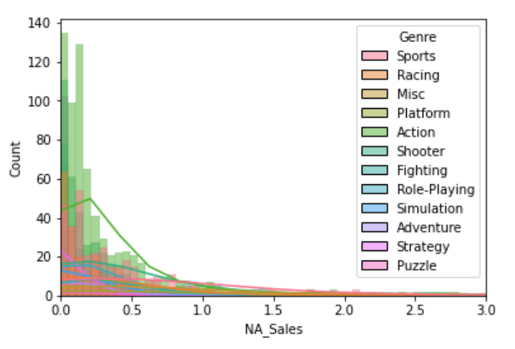
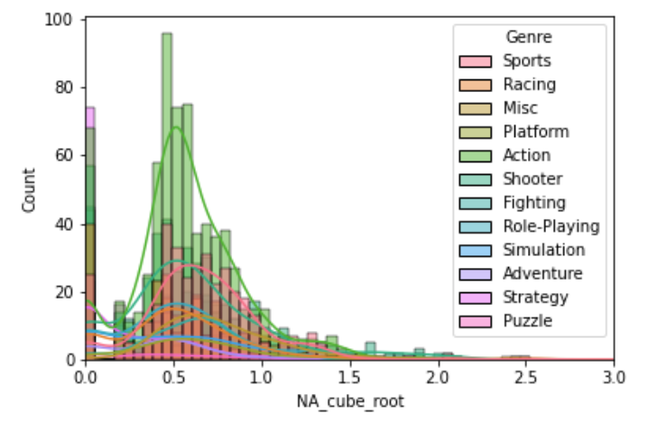
Histograms
North American (NA) Sales
Observations
Most values <$1M
Avg: ~$450K
Max: $41.3M
Large disparity
Outliers: square root or cube root transformation

Slide 8
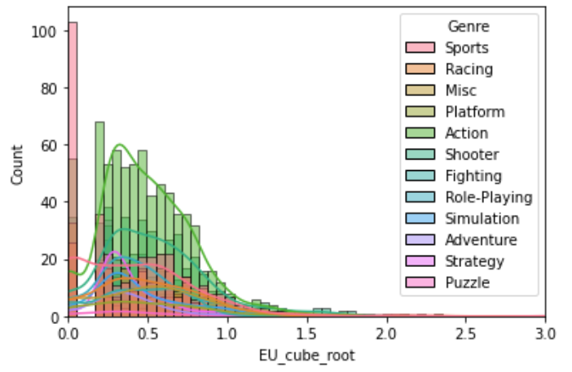
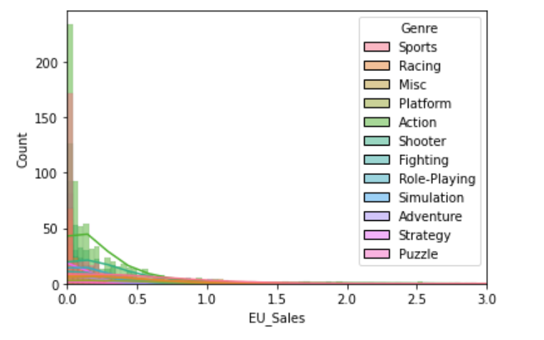
Histograms
EU Sales
Observations
< Volume compare with NA
Action best selling genre; followed by racing
Mean: ~$300K
Max: ~$29M
Cube root transform

Slide 9
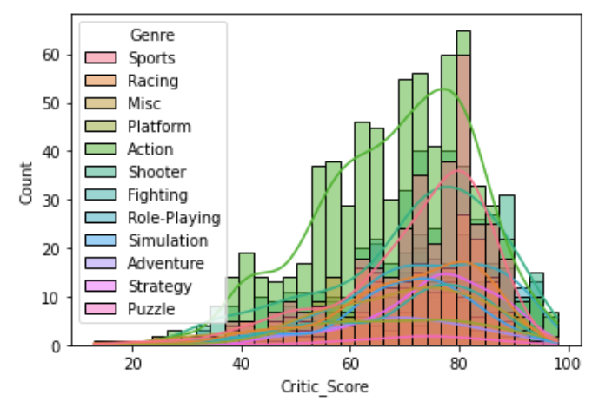
Histograms
Critic Scores
Slight negative skew
Large volume of action/sports games
Mode around 80
Mean: ~70.5
Max: ~98.0 (highest critic rating)

Slide 10
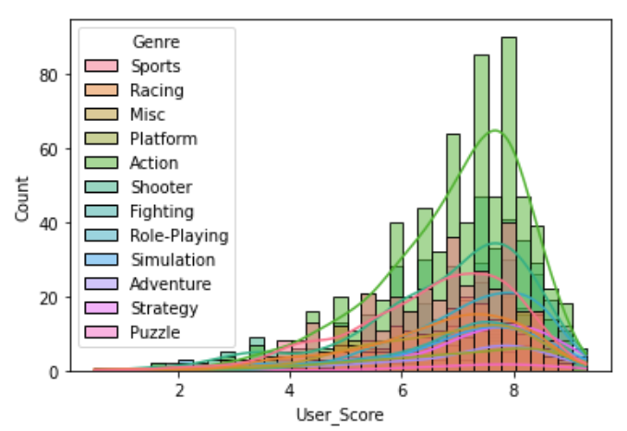
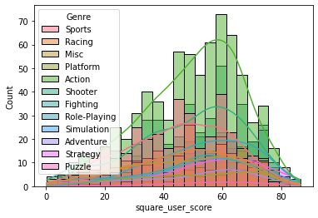
Histograms
User Scores
Similar slight negative skew to critic scores
Action, sport, shooter genres by far most highly rated
Due to more titles in those genres
Squaring values could help normalize distribution

Slide 11
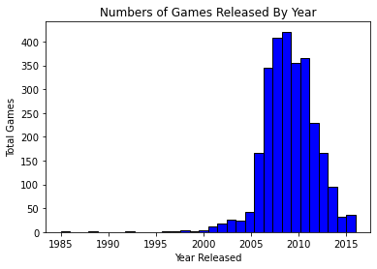
Histograms
Distribution of number of games released each year
Date range: 1985 – 2016
Most games released between 2005 and 2011
Would expect continuous increase or leveling off
Decrease perhaps due to observations being dropped during data cleaning
Focusing on titles released between 1995-2015 would mitigate down outlier impact

Slide 12
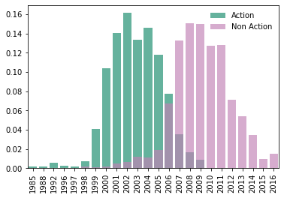
Probability Mass Function (PMF)
See probability of year of release based on genre
Created subset of only action vs subset of non-action genre video games
PMF results indicate that action games were more likely to come in the early 2000s while non-action titles became more likely/popular in more recent years

Slide 13
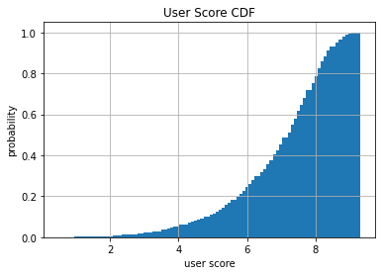
Cumulative Distribution Function (CDF)
Chosen variable: User_Score
Q: How many video games achieved a user rating > 8?
A: Only about 20% of the games in the dataset
Useful for extra information about how data is distributed

Slide 14
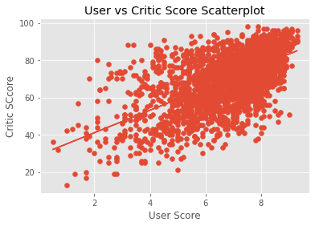
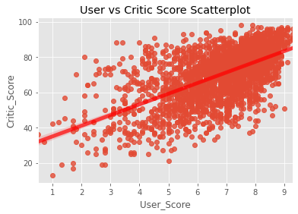
Scatter Plots with regression line
Critic Score vs. User Score
Two Python methods:
Matplotlib (top)
Seaborn (bottom)
More evident
Fit regression line with additional params
Positive linear relationship between two variables
Clusters heavy in the > 5.0/50.0 range

Slide 15
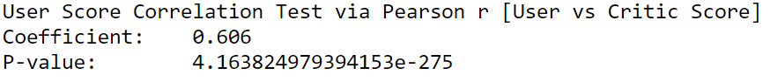
Correlation Testing
Chosen coefficient → Pearson’s r
Implemented via scipy’s stats.pearsonr() function
Both Pearson coef are strong
Especially between other and global sales (0.92)
P-value both < .005 indicating statistical significance

Slide 16

Conclusions
Outliers of most profitable games > $20M
Most ‘normal’ rest between $300K and 800K
NA by far most profitable region for video game sales
Evident by most consumers
Action genre very popular in early 2000’s
Other genres have seen increased popularity in recent years
Most profitable/popular genres:
Action, shooter, sports
Consistent throughout the years

